Slide 1
Cardiac1 Anmool Shah
Final Data Exploration Assignment.
TU856

Slide 2
Data Preparation and Cleaning

Slide 3
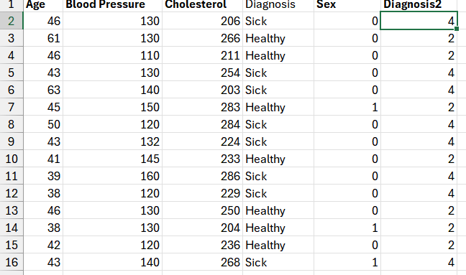
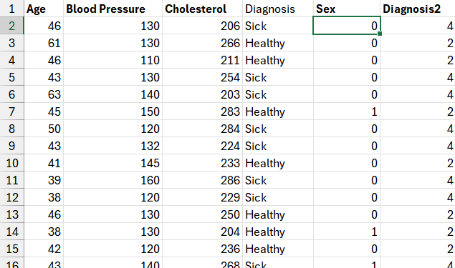
Data Prep
IF statements for
Diagnosis and Sex columns
0 for Male
1 for Female
2 for Healthy
4 for Unhealthy

Slide 4
Data Quality Report
Variable | Max | Min | Count | Mean | Nulls
Age | 67 | 34 | 306 | 49.6197 | 0
Sex | 1 | 0 | 306 | 0.31803 | 0
Blood Pressure | 200 | 94 | 306 | 131.58 | 0
Cholesterol | 564 | 126 | 306 | 245.898 | 0
Diagnosis | 4 | 2 | 306 | 2.91148 | 1

Slide 5
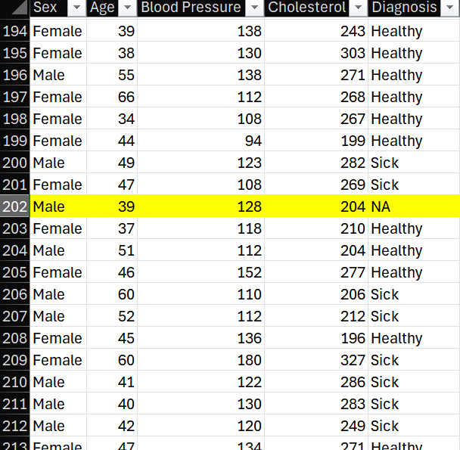
Nulls
Based off his cholesterol and blood pressure I gave him a healthy diagnosis

Slide 6
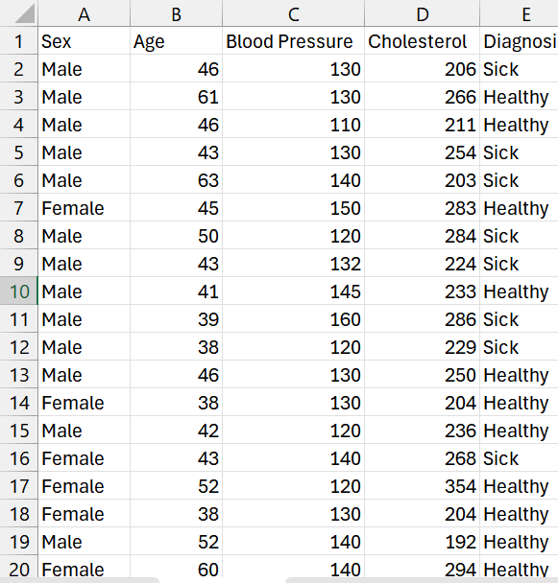
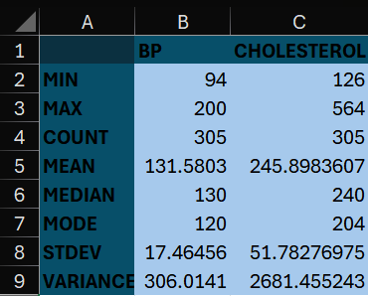
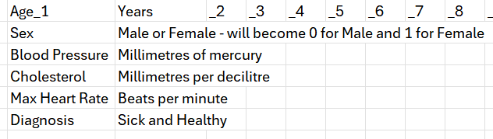
Data Prep

Slide 7
2. Data Exploration

Slide 8
Diagnosis
54% of the sample were given the Healthy diagnosis while 46% were Unhealthy

Slide 9
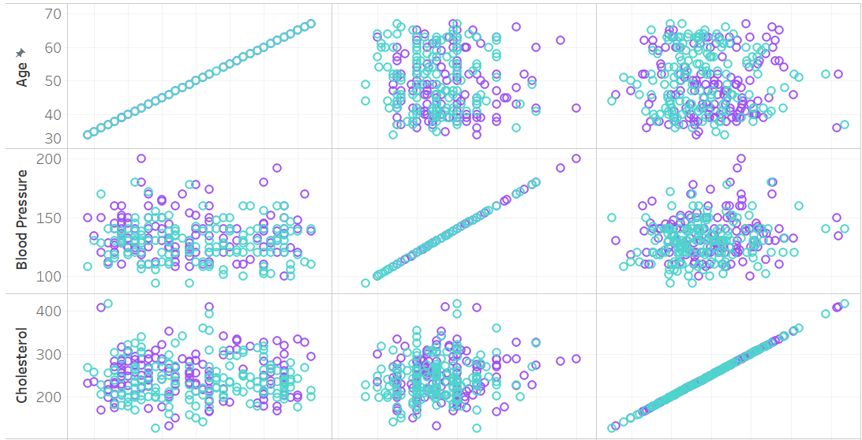
Scatterplot Matrix

Slide 10
68% of the sample were male while 32% were female
23% of Males were Healthy
23% of Males were Healthy

Slide 11
Most of the sample lied between ages 41-50
In general less of the sample
lied between 61-70

Slide 12
3. Comparative Analysis

Slide 13
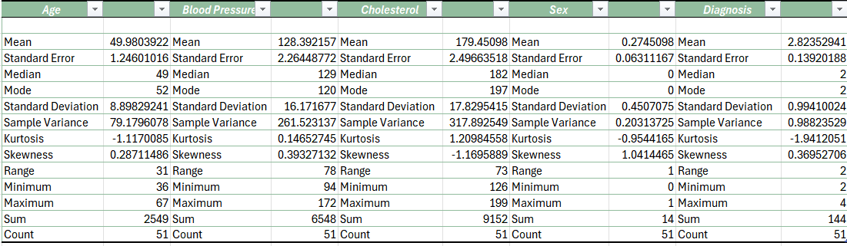
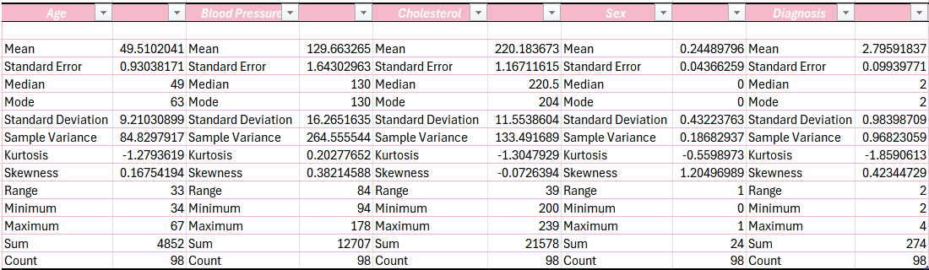
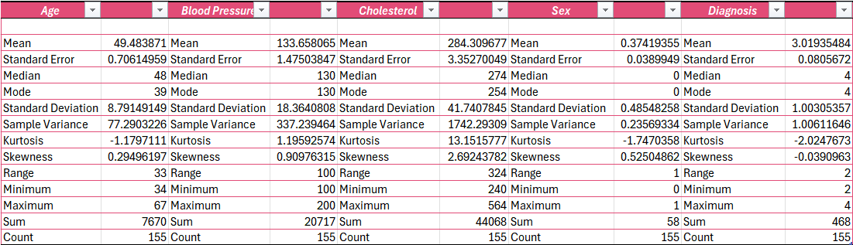
SubGroup Summary Analysis:

Slide 14
SubGroup Summary Visualisation:
Mean BP increased by 4% between normal and high cholesterols
Mean cholesterol increased by 58% between and high cholesterol

Slide 15
4. Hypothesis Test

Slide 16
Null Hypothesis
There is no correlation between the diagnosis given to the patient and their cholesterol levels
Alternative Hypothesis
There is a significance correlation between the diagnosis given to the patient and their cholesterol levels

Slide 17
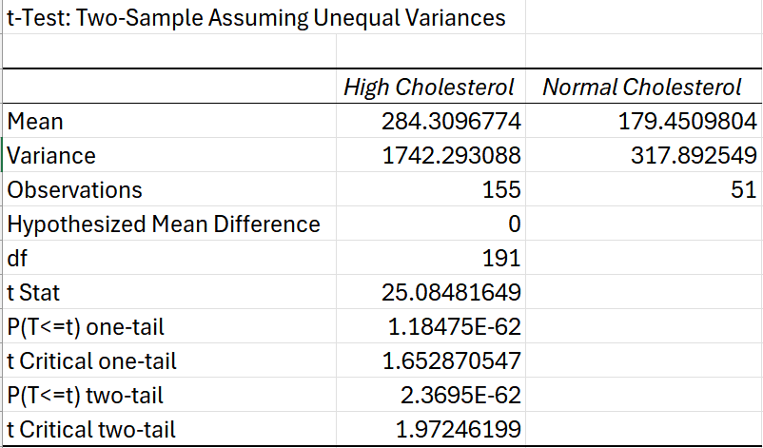
Results
Since the p-value (both one-tailed and two-tailed) is much smaller than the significance level we reject the null hypothesis.
The t-statistic falls into the rejection region.
We conclude that there is a statistically significant difference in mean cholesterol levels between patients diagnosed with high cholesterol and those diagnosed with normal cholesterol.

Slide 18
5. Linear Regression

Slide 19
Discussion
The p-value associated with the coefficient of Cholesterol is 0, which is less than the significance level
Therefore, we reject the null hypothesis and conclude that there is a significant correlation between the diagnosis given to the patient and their cholesterol levels.
yhat = 55.E -17 + 0.001582522x
In other words, the cholesterol level is a significant predictor of the diagnosis given to the patient.

Slide 20
5. Conclusions
There is a correlation between cholesterol levels and the patients’ diagnosis 👍

